Slide 1
Introduction to DBMS
By
Rushali Patil

Slide 2
Outline
Definition
Data
Database
DBMS

Slide 3

Data
References
Text
Audios
Numbers
Videos
Images

Slide 4
What is Database?
Miniworld or Universe of Discourse (UoD)
A collection of data with implicit meaning
Meant for Specific Purpose or Intended Group of Users

Slide 5
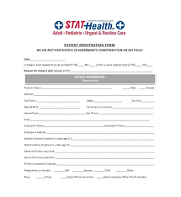
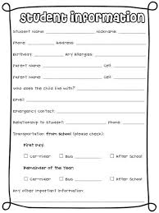


Examples of Database
Database

Slide 6
DBMS-Definition
DBMS- Database Management System
Def:
A collection of programs that enables users to create and maintain a database.
A general-purpose software system that facilitates the processes of defining, constructing, and manipulating databases for various applications

Slide 7


DBMS
Set of Programs
Dataset 1
User 1
Dataset 2
Dataset 3
User 2

Slide 8
Pre-activity
Produce information of students securing first class.
Produce information of students securing distinction.
Give details of students with maximum no of co-curriculum activities.
Get academic information of faculties.
Book movie tickets for Ram and Sham.

Slide 9
Drawbacks of Traditional File System
Data redundancy and inconsistency
Multiple file formats, duplication of information in different files
Difficulty in accessing data
Need to write a new program to carry out each new task
Data isolation
Multiple files and formats
Integrity problems
Integrity constraints (e.g., account balance > 0) become “buried” in program code rather than being stated explicitly
Hard to add new constraints or change existing ones
Notes:
9

Slide 10
Drawbacks of Traditional File System
Atomicity of updates
Failures may leave database in an inconsistent state with partial updates carried out
Example: Transfer of funds from one account to another should either complete or not happen at all
Concurrent access by multiple users
Concurrent access needed for performance
Uncontrolled concurrent accesses can lead to inconsistencies
Example: Two people reading a balance (say 100) and updating it by withdrawing money (say 50 each) at the same time
Security problems
Hard to provide user access to some, but not all, data
Notes:
10

Slide 11
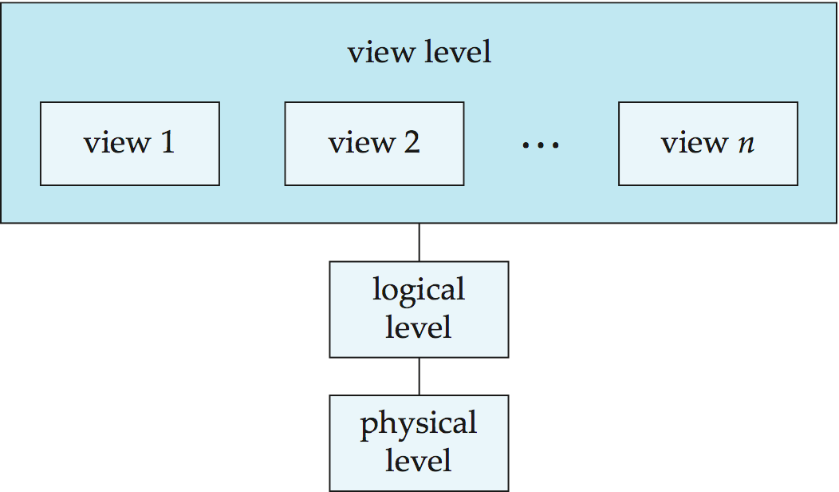
View of Data
To provide users with an abstract view of the data
Three levels of data abstraction
Notes:
11

Slide 12
Levels of Abstraction
Physical level: describes how a record (e.g., instructor) is stored.
Logical level: describes data stored in database, and the relationships among the data.
type instructor = record
ID : string; name : string; dept_name : string; salary : integer;
end;
View level: application programs hide details of data types. Views can also hide information (such as an employee’s salary) for security purposes.
Notes:
12

Slide 13
Instances and Schemas
Instance- The collection of information stored in the database at a particular moment
Schema- Overall design of the database
Similar to types and variables in programming languages
Logical Schema – the overall logical structure of the database
Example: The database consists of information about a set of customers and accounts in a bank and the relationship between them
Analogous to type information of a variable in a program
Physical schema– the overall physical structure of the database
Instance – the actual content of the database at a particular point in time
Analogous to the value of a variable
Physical Data Independence – the ability to modify the physical schema without changing the logical schema
Applications depend on the logical schema
In general, the interfaces between the various levels and components should be well defined so that changes in some parts do not seriously influence others.
Notes:
13

Slide 14
Data Models
Data model : It is a collection of conceptual tools for describing
Data
Data relationships
Data semantics
Data constraints
Data models classifications:
Relational model
Entity-Relationship data model (mainly for database design)
Object-based data models (Object-oriented and Object-relational)
Semistructured data model (XML)
Other older models (used in old databases):
Network model
Hierarchical model
Notes:
14

Slide 15
Databases Languages
Database languages are classified into four categories:
DDL-Data Definition Language
DML-Data Manipulation Language
DCL-Data Control Language
TCL- Transaction Control Language

Slide 16
Data Definition Language(DDL)
It creates the framework of the database by specifying the database schema, which is the structure that represents the organization of data
The list of DDL statements:
CREATE: Creates a new database or object, such as a table, index or column
ALTER: Changes the structure of the database or object
DROP: Deletes the database or existing objects
RENAME: Renames the database or existing objects

Slide 17
Data Definition Language (DDL)
Example: create table instructor ( ID char(5), name varchar(20), dept_name varchar(20), salary numeric(8,2))
DDL compiler generates a set of table templates stored in a data dictionary
Data dictionary contains metadata (i.e., data about data)
Database schema
Integrity constraints
Primary key (ID uniquely identifies instructors)
Authorization
Who can access what
Notes:
17

Slide 18
Data Manipulation Language (DML)
Language for accessing and manipulating the data organized by the appropriate data model
DML also known as query language
Two classes of languages
Pure – used for proving properties about computational power and for optimization
Relational Algebra
Tuple relational calculus
Domain relational calculus
Commercial – used in commercial systems
SQL is the most widely used commercial language
Notes:
18

Slide 19
Data Manipulation Language (DML)
The list of DML statements:
INSERT: Adds new data to the existing database table
UPDATE: Changes or updates values in the table
DELETE: Removes records or rows from the table
SELECT: Retrieves data from the table or multiple tables
Notes:
19

Slide 20
Data Control Language (DCL)
Data control language (DCL) controls access to the data that users store within a database.
It controls the rights and permissions of the database system.
It allows users to grant or revoke privileges to the database.
The list of DCL statements:
GRANT: Gives a user access to the database
REVOKE: Removes a user's access to the database
Notes:
20

Slide 21
Transaction Control Language (TCL)
Transaction control language (TCL) manages the transactions within a database.
Transactions group a set of related tasks into a single, executable task.
All the tasks must succeed in order for the transaction to work.
The list of TCL statements:
COMMIT: Carries out a transaction
ROLLBACK: Restores a transaction if any tasks fail to execute
Notes:
21

Slide 22
SQL
Structured Query Language
The standard language for Relational Database System
The most widely used commercial language
To be able to compute complex functions SQL is usually embedded in some higher-level language
Application programs generally access databases through one of
Language extensions to allow embedded SQL
Application program interface (e.g., ODBC/JDBC) which allow SQL queries to be sent to a database
Notes:
22

Slide 23
Applications of SQL
Allows users
to access data in the relational database management systems.
to describe the data
to define the data in a database and manipulate that data
to embed within other languages using SQL modules, libraries & pre-compilers
to create and drop databases and tables
to create view, stored procedure, functions in a database
to set permissions on tables, procedures and views.

Slide 24
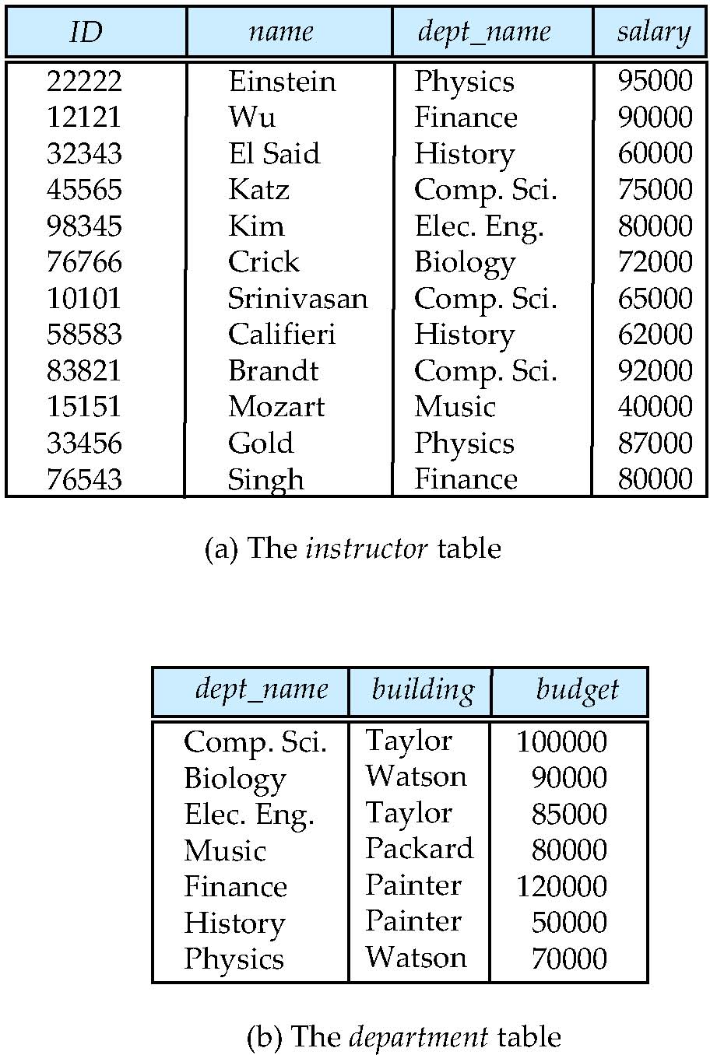
Relational Model
All the data is stored in various tables.
Example of tabular data in the relational model
Columns
Rows
Notes:
24

Slide 25
A Sample Relational Database
Notes:
25

